Slide 1
Induced Surface Charge
Xuan Ruan

Slide 2
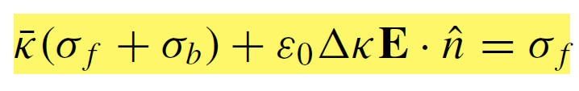










Equations
$$E$$
$$\hat{n}$$
Governing equation:
$$σ_{f}+σ_{b}$$
$$κ_{out}$$
$$κ_{in}$$
Dielectric constant:
Unknown
Known

Slide 3
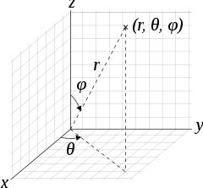
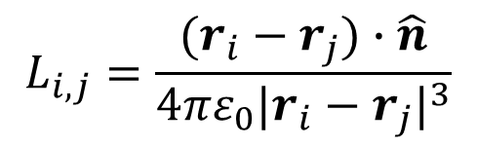

Equations
$$E$$
$$\hat{n}$$
$$σ_{f}+σ_{b}$$
$$κ_{out}$$
Unknown
Known
$$κ_{in}$$
$$\overline{κ}σ_{b,i}+ε_{0}ΔκL_{i,j}({dSσ}_{b,j})=b_{i}$$
$$L_{i,j}=\frac{(r_{i}−r_{j})∙\hat{n}}{4πε_{0}{|r_{i}−r_{j}|}^{3}}$$

Slide 4
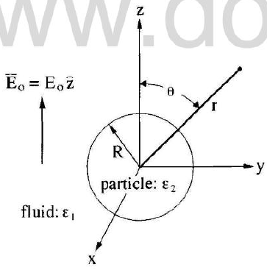


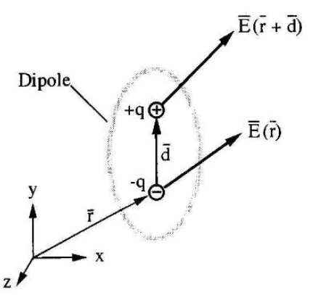
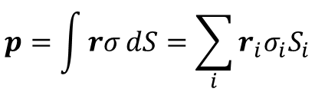

Dielectric ball in an external field
Thomas Jones, Electromechanics of Particles, 1995.
Theoretical solution:
Coefficient A:
Dipole: $p=qd$
$$p=\int{rσ}dS=\sum_{i}{r_{i}σ_{i}S_{i}}$$
Integral form
Discrete form

Slide 5
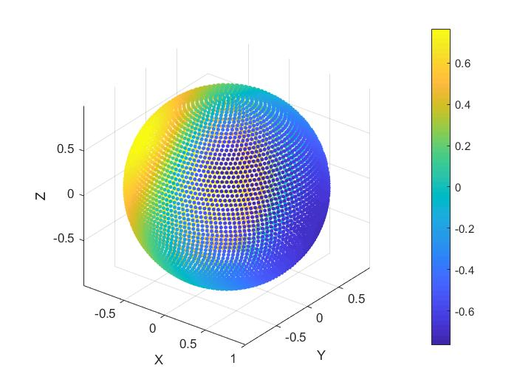
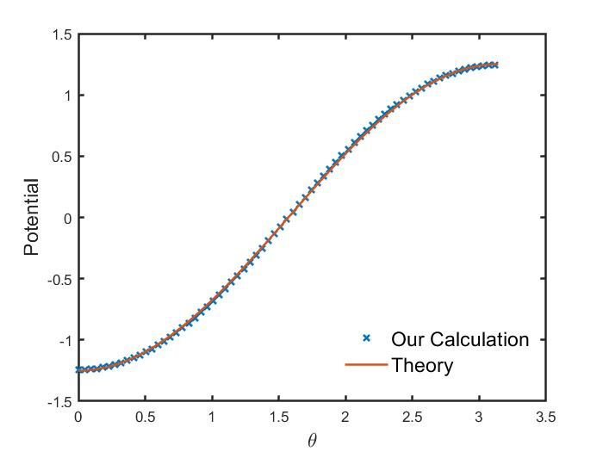
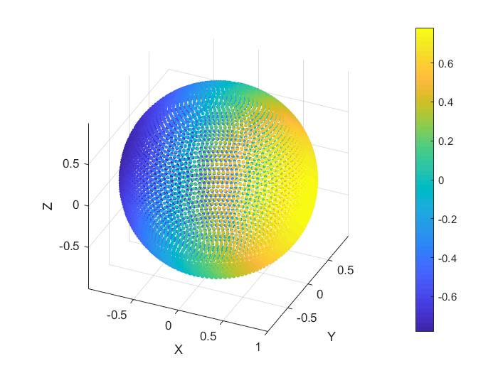
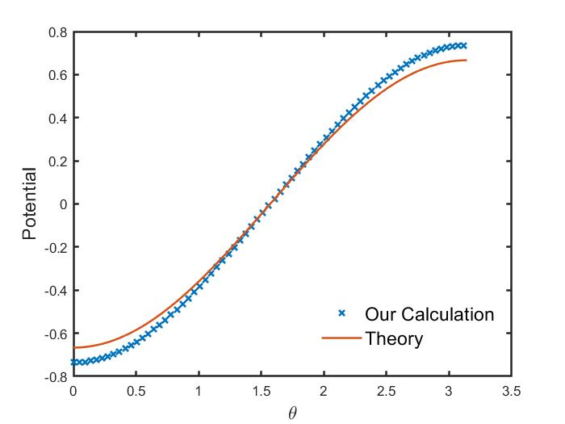

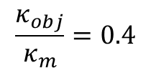




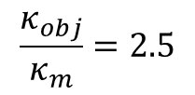
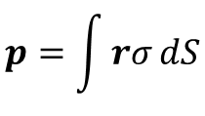
Dielectric ball in an electric field
$$N=6000,\frac{d_{pointcharge}}{R}=0.05$$
$$p=\int{rσ}dS$$
$$\frac{κ_{obj}}{κ_{m}}=0.4$$
$$d_{p,our}=[−3.50,0,0]$$
$$d_{p,theory}=[−3.14,0,0]$$
$$\frac{κ_{obj}}{κ_{m}}=2.5$$
$$d_{p,our}=[3.612,0,0]$$
$$d_{p,theory}=[4.19,0,0]$$

Slide 6
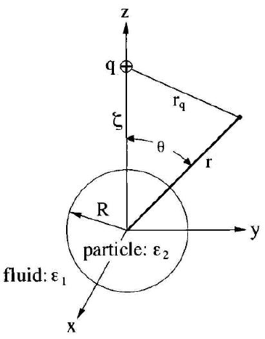



Dielectric ball in field of point charge
Thomas Jones, Electromechanics of Particles, 1995.
Theoretical solution:
Coefficient An:
Legendre polynomial Pn:

Slide 7
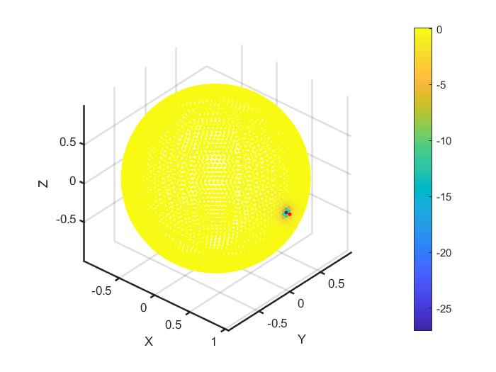
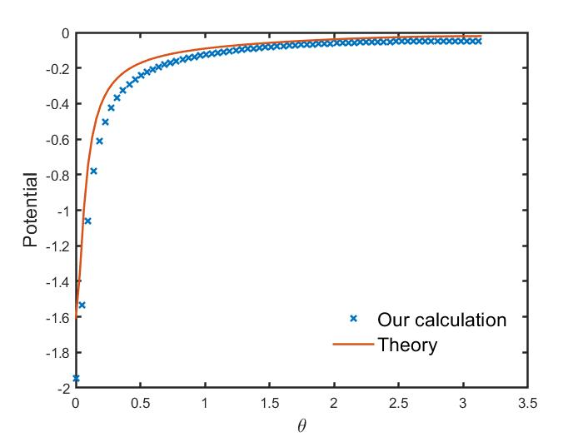
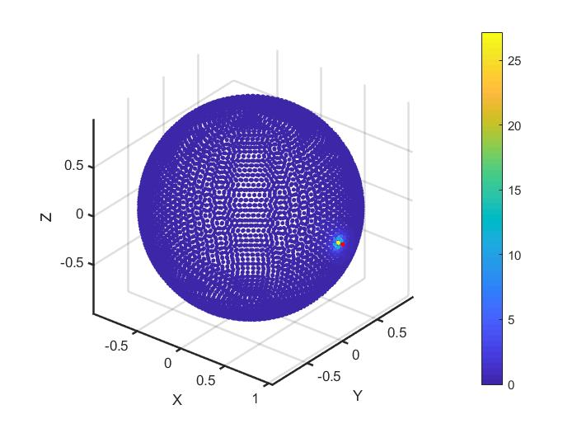
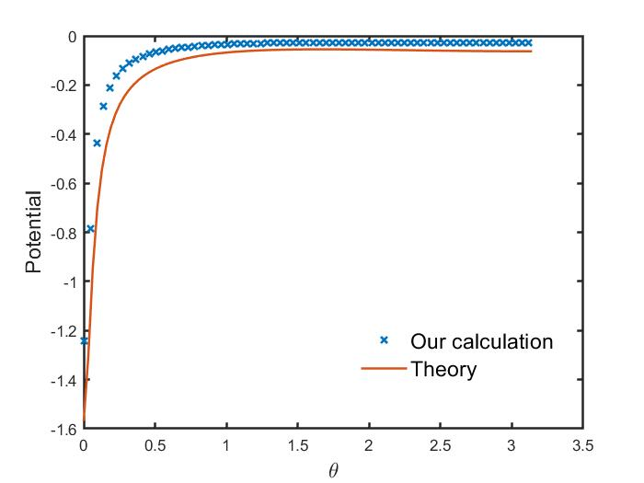
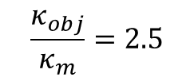
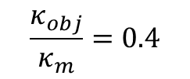
Dielectric ball in field of point charge
Wrong
$$N=6000,\frac{d_{pointcharge}}{R}=0.05$$
$$\frac{κ_{obj}}{κ_{m}}=0.4$$
$$\frac{κ_{obj}}{κ_{m}}=2.5$$

Slide 8
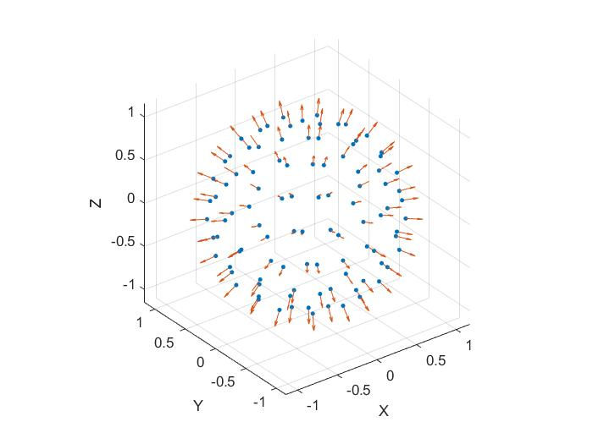
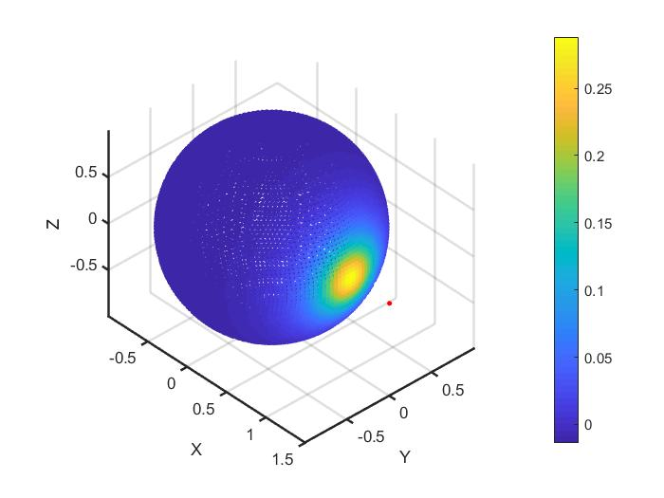
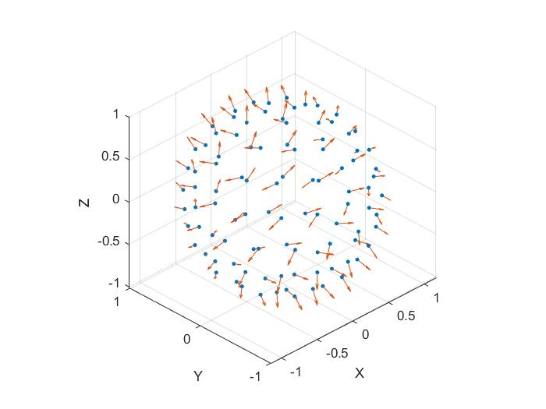

Bug
From here
Correct
$$N=8000$$

Slide 9
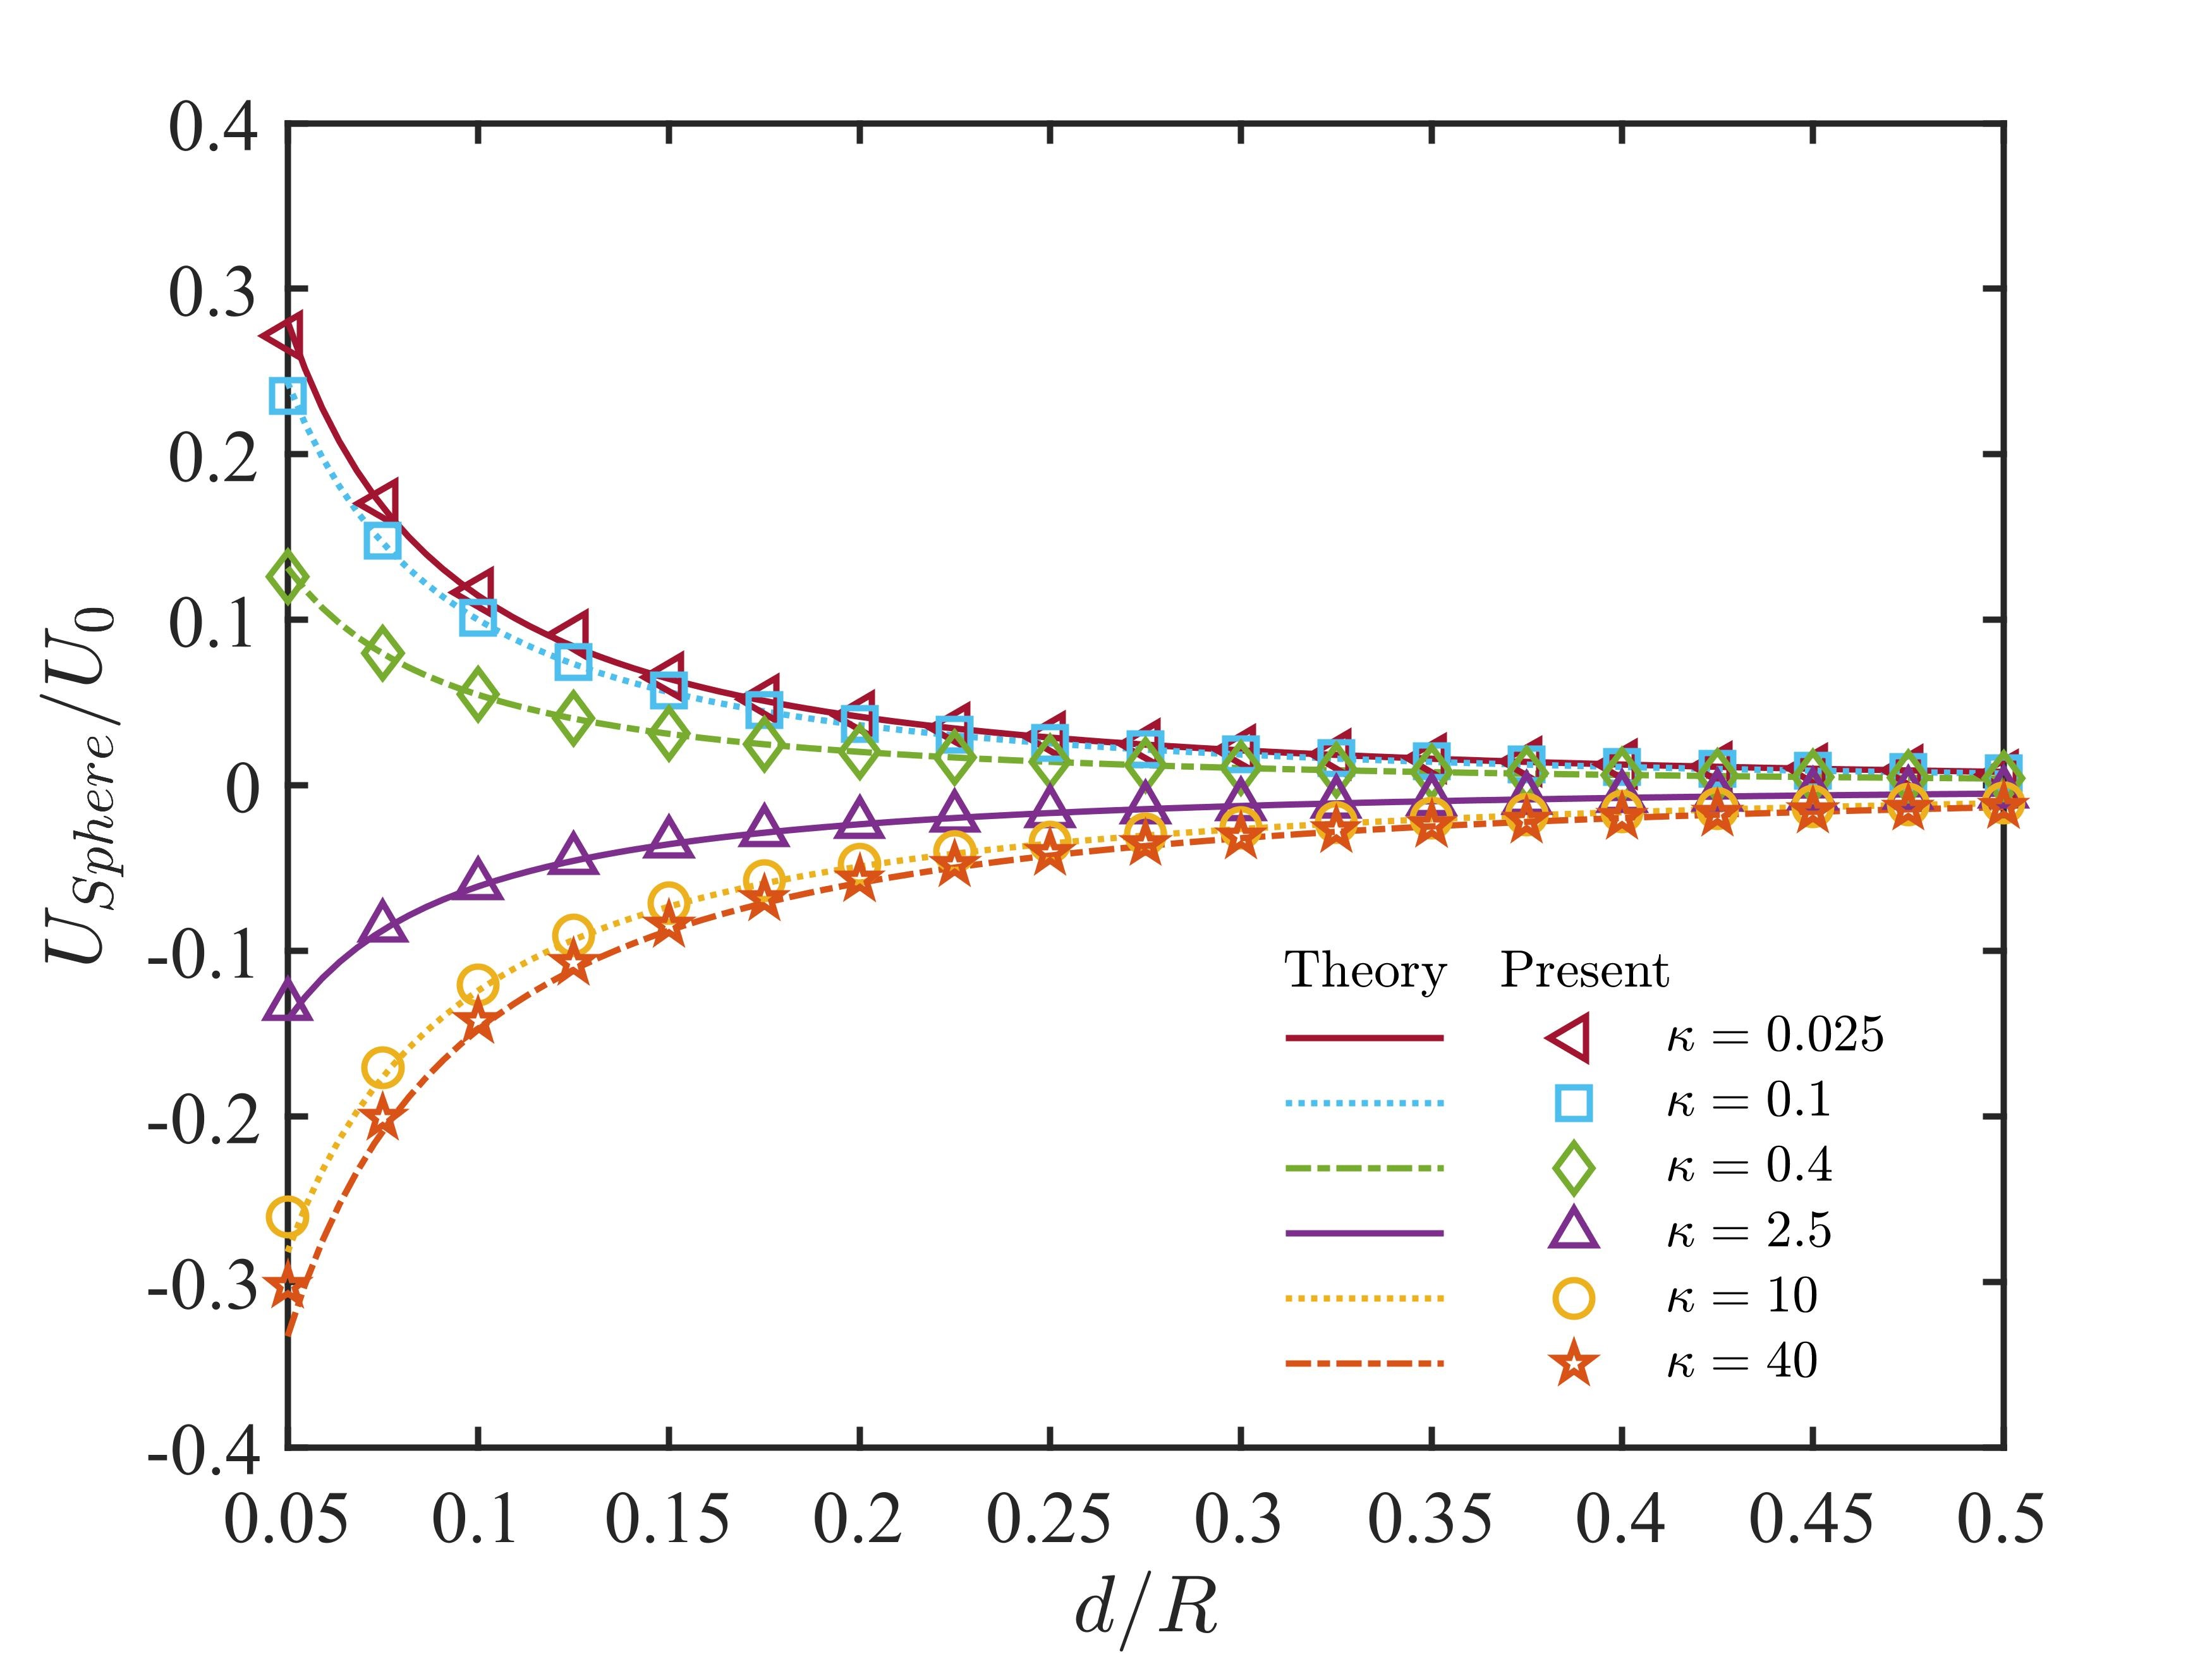


Dielectric ball in field of point charge
Correct
Barros & Luijten, PRL, 2014
$$U_{0}=\frac{q^{2}}{πε_{0}κ_{m}R}$$

Slide 10
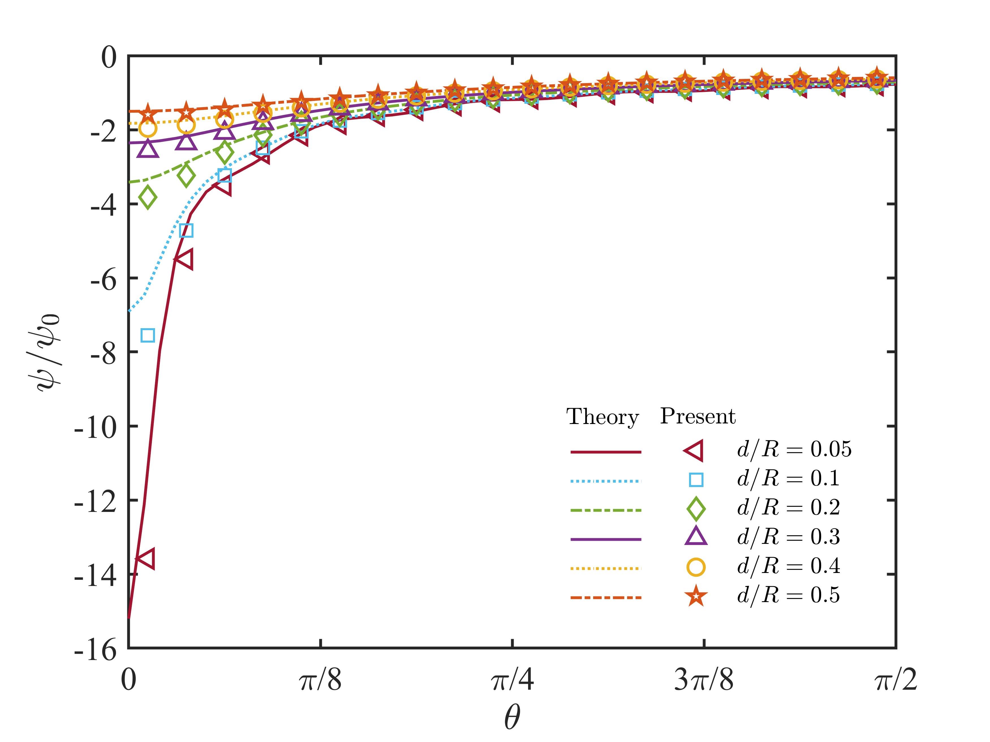


Dielectric ball in field of point charge
Correct
Jones, 1995
$$\frac{κ_{obj}}{κ_{m}}=2.5, N=2000$$
$$ψ_{0}=\frac{|q|}{4πε_{0}R}$$

Slide 11
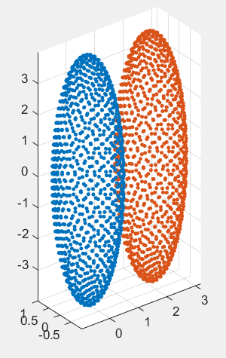




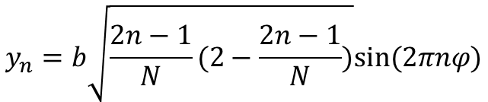
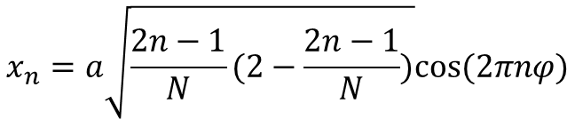
Nearly Uniform Patches
Correct
$$f=\frac{x^{2}}{a^{2}}+\frac{y^{2}}{b^{2}}+\frac{z^{2}}{c^{2}}−1=0$$
Coordinates of N patches:
Goes from –c to c
$$z_{n}=c∙(\frac{2n−1}{N}−1)$$
$$x_{n}=a\sqrt{\frac{2n−1}{N}(2−\frac{2n−1}{N})}cos⁡(2πnφ)$$
$$y_{n}=b\sqrt{\frac{2n−1}{N}(2−\frac{2n−1}{N})}sin⁡(2πnφ)$$
$$φ=(\sqrt{5}−1)/2$$
$$n=1,2,…,N$$
http://extremelearning.com.au/how-to-evenly-distribute-points-on-a-sphere-more-effectively-than-the-canonical-fibonacci-lattice/
https://bduvenhage.me/geometry/2019/07/31/generating-equidistant-vectors.html

Slide 12
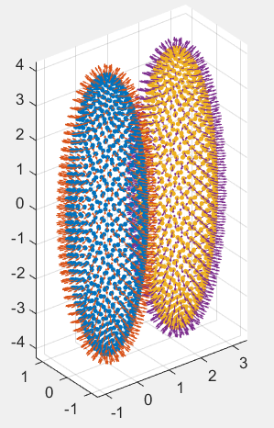
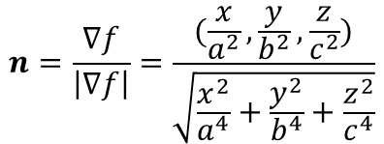
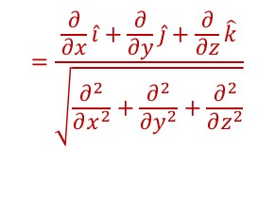
Normal Vector
Correct
$$f=\frac{x^{2}}{a^{2}}+\frac{y^{2}}{b^{2}}+\frac{z^{2}}{c^{2}}−1=0$$
$$n=\frac{∇f}{\left|∇f\right|}=\frac{(\frac{x}{a^{2}},\frac{y}{b^{2}},\frac{z}{c^{2}})}{\sqrt{\frac{x^{2}}{a^{4}}+\frac{y^{2}}{b^{4}}+\frac{z^{2}}{c^{4}}}}$$
$$=\frac{\frac{∂}{∂x}\hat{i}+\frac{∂}{∂y}\hat{j}+\frac{∂}{∂z}\hat{k}}{\sqrt{\frac{∂^{2}}{∂x^{2}}+\frac{∂^{2}}{∂y^{2}}+\frac{∂^{2}}{∂z^{2}}}}$$

Slide 13
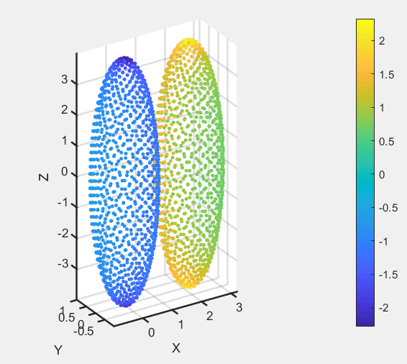
Results
Aspect ratio = 4
S ≈ 4π [ ( a^{p}b^{p} + a^{p}c^{p} + b^{p}c^{p} ) / 3 ] ^{1/p}

Slide 14
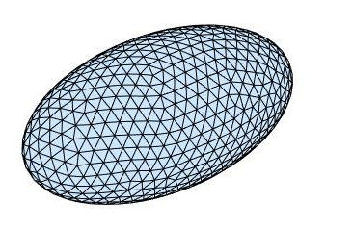
Unstructured triangular mesh
Distmesh: A Simple Mesh Generator in MATLAB
http://persson.berkeley.edu/distmesh/
P.-O. Persson, G. Strang, A Simple Mesh Generator in MATLAB.
SIAM Review, Volume 46 (2), pp. 329-345, 2004
P.-O. Persson, Mesh Generation for Implicit Geometries.
Ph.D. thesis, Department of Mathematics, MIT, 2004

Slide 15
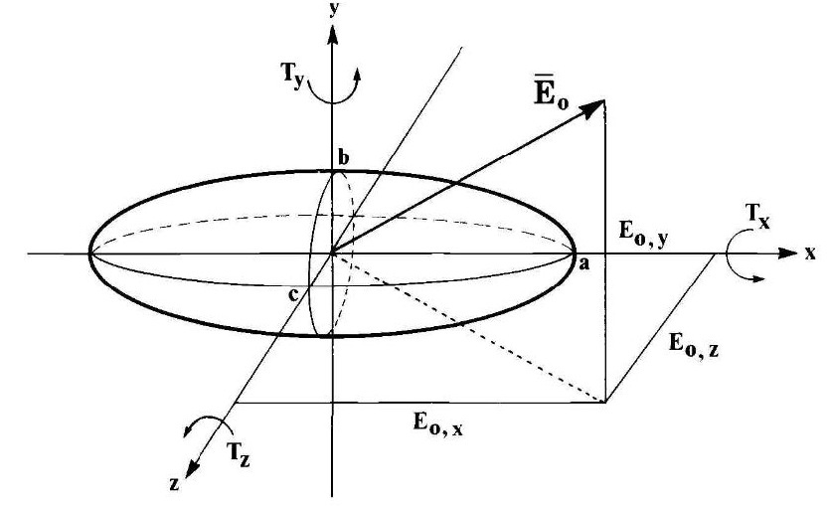




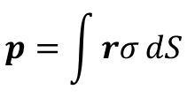
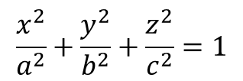
Validation
Thomas Jones, Electromechanics of Particles, 1995.
$$\frac{x^{2}}{a^{2}}+\frac{y^{2}}{b^{2}}+\frac{z^{2}}{c^{2}}=1$$
Effective dipole:
$$p=\int{rσ}dS$$

Slide 16
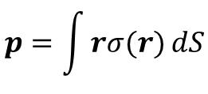
Validation
Geometry |  |  | External Field |  |  | Calculation |  |  |  | Theory
a | b | c | Ex | Ey | Ez | px | py | pz | N_patch | px | py | pz
1 | 1 | 1 | 1 | 0 | 0 | 4.085275 | -0.00118 | 0.012072 | 480 | 4.18879 | 0 | 0
2 | 1 | 1 | 1 | 0 | 0 | 9.716864 | -0.00066 | -0.00203 | 784 | 9.970572 | 0 | 0
4 | 1 | 1 | 1 | 0 | 0 | 21.58781 | 0.000159 | -0.00163 | 1408 | 22.57883 | 0 | 0
8 | 1 | 1 | 1 | 0 | 0 | 45.50925 | -0.00374 | 0.006583 | 2672 | 48.21018 | 0 | 0
2 | 2 | 1 | 1 | 0 | 0 | 18.25061 | -0.00415 | -0.00055 | 1272 | 18.55363 | 0 | 0
4 | 4 | 1 | 1 | 0 | 0 | 82.05909 | 0.045306 | 0.015877 | 3744 | 82.24947 | 0 | 0
$$p=\int{rσ(r)}dS$$

Slide 17

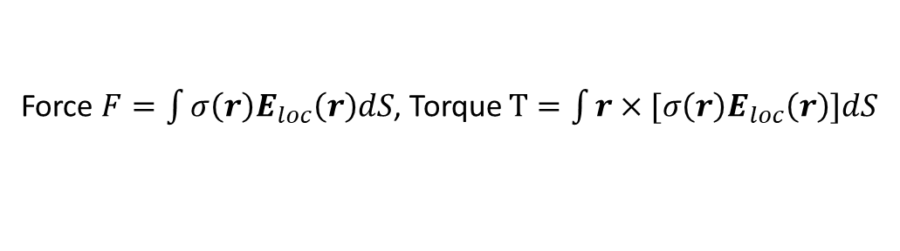
Ongoing work
Initial discretization
External field $E$, free charge $σ_{f}$
Bound charge $σ_{b}$, local field $E_{loc}=E+E_{f}+E_{b}$
Force $F=\int{σ\left(r\right)E_{loc}\left(r\right)dS}$, Torque $T=\int{r×[σ\left(r\right)E_{loc}\left(r\right)]dS}$
Ellipsoid translation and rotation (collision detection)
Update patch location and normal vector

Slide 18
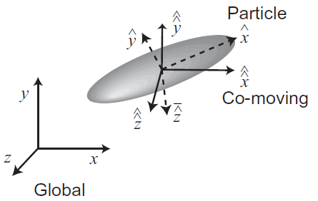
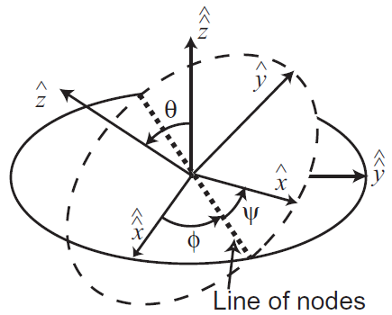

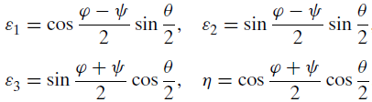
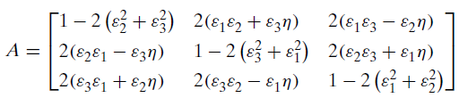




Ellipsoid dynamics
Euler angles: $(φ,θ,ψ)$
$$v^{p}=Av^{cm}$$
$$v^{cm}=A^{−1}v^{p}$$
Quaternions: $(ε_{1},ε_{2},ε_{3},η)$

Slide 19
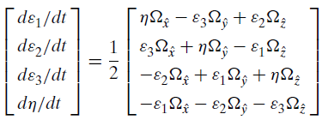
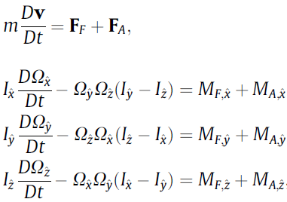

Ellipsoid dynamics
$$Ω^{p}=AΩ^{cm}$$

Slide 20
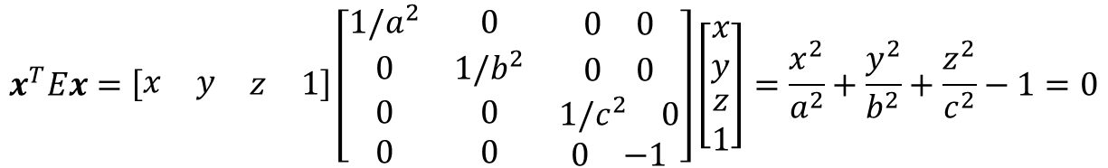





Collision
Pick out possible collision pairs
Check each possible pairs
If collision happens, find out the collision point
Calculate post-collision velocity/rotation rate
(1) Pick out possible collision pairs
$$\left|r_{p,i}−r_{p,j}\right|<r_{crit}=3×max⁡(a,b,c)$$
(2) Check each possible pairs
$$x^{T}Ex=\left[\begin{matrix}x & y & \begin{matrix}z & 1\end{matrix}\end{matrix}\right]\left[\begin{matrix}1/a^{2} & 0 & \begin{matrix}0 & 0\end{matrix} \\ 0 & 1/b^{2} & \begin{matrix}0 & 0\end{matrix} \\ \begin{matrix}0 \\ 0\end{matrix} & \begin{matrix}0 \\ 0\end{matrix} & \begin{matrix}\begin{matrix}1/c^{2} & 0\end{matrix} \\ \begin{matrix}0 & −1\end{matrix}\end{matrix}\end{matrix}\right]\left[\begin{matrix}x \\ y \\ \begin{matrix}z \\ 1\end{matrix}\end{matrix}\right]=\frac{x^{2}}{a^{2}}+\frac{y^{2}}{b^{2}}+\frac{z^{2}}{c^{2}}−1=0$$
$$x^{T}E_{1}x=0$$
$$x^{T}({λE}_{1}−E_{2})x=0$$
Eigen values of ${E_{1}}^{−1}E_{2}$
$$x^{T}E_{2}x=0$$

Slide 21

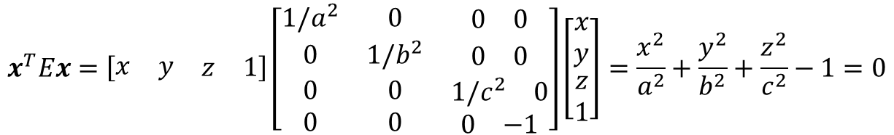
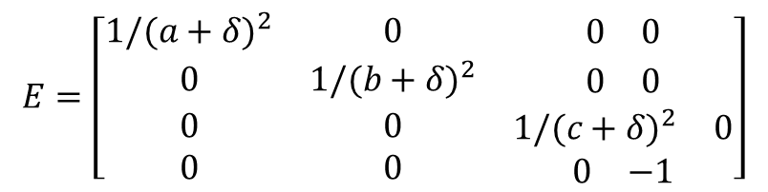
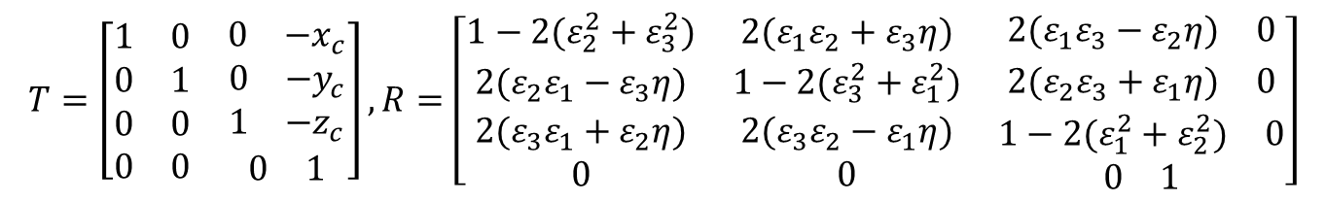
Collision
$$x^{T}Ex=\left[\begin{matrix}x & y & \begin{matrix}z & 1\end{matrix}\end{matrix}\right]\left[\begin{matrix}1/a^{2} & 0 & \begin{matrix}0 & 0\end{matrix} \\ 0 & 1/b^{2} & \begin{matrix}0 & 0\end{matrix} \\ \begin{matrix}0 \\ 0\end{matrix} & \begin{matrix}0 \\ 0\end{matrix} & \begin{matrix}\begin{matrix}1/c^{2} & 0\end{matrix} \\ \begin{matrix}0 & −1\end{matrix}\end{matrix}\end{matrix}\right]\left[\begin{matrix}x \\ y \\ \begin{matrix}z \\ 1\end{matrix}\end{matrix}\right]=\frac{x^{2}}{a^{2}}+\frac{y^{2}}{b^{2}}+\frac{z^{2}}{c^{2}}−1=0$$
Translation ($T$) + Rotation ($R$): $x_{p}=RTx$
$$T=\left[\begin{matrix}1 & 0 & \begin{matrix}0 & −x_{c}\end{matrix} \\ 0 & 1 & \begin{matrix}0 & −y_{c}\end{matrix} \\ \begin{matrix}0 \\ 0\end{matrix} & \begin{matrix}0 \\ 0\end{matrix} & \begin{matrix}\begin{matrix}1 & −z_{c}\end{matrix} \\ \begin{matrix}0 & 1\end{matrix}\end{matrix}\end{matrix}\right],R=\left[\begin{matrix}1−2(ε_{2}^{2}+ε_{3}^{2}) & 2(ε_{1}ε_{2}+ε_{3}η) & \begin{matrix}2(ε_{1}ε_{3}−ε_{2}η) & 0\end{matrix} \\ 2(ε_{2}ε_{1}−ε_{3}η) & 1−2(ε_{3}^{2}+ε_{1}^{2}) & \begin{matrix}2(ε_{2}ε_{3}+ε_{1}η) & 0\end{matrix} \\ \begin{matrix}2(ε_{3}ε_{1}+ε_{2}η) \\ 0\end{matrix} & \begin{matrix}2(ε_{3}ε_{2}−ε_{1}η) \\ 0\end{matrix} & \begin{matrix}\begin{matrix}1−2(ε_{1}^{2}+ε_{2}^{2}) & 0\end{matrix} \\ \begin{matrix}0 & 1\end{matrix}\end{matrix}\end{matrix}\right]$$
$${\left(RTx\right)}^{T}E\left(RTx\right)=x^{T}\left(T^{T}R^{T}ERT\right)x=x^{T}E^{∗}x$$
$$E=\left[\begin{matrix}1/{(a+δ)}^{2} & 0 & \begin{matrix}0 & 0\end{matrix} \\ 0 & 1/{(b+δ)}^{2} & \begin{matrix}0 & 0\end{matrix} \\ \begin{matrix}0 \\ 0\end{matrix} & \begin{matrix}0 \\ 0\end{matrix} & \begin{matrix}\begin{matrix}1/{(c+δ)}^{2} & 0\end{matrix} \\ \begin{matrix}0 & −1\end{matrix}\end{matrix}\end{matrix}\right]$$

Slide 22
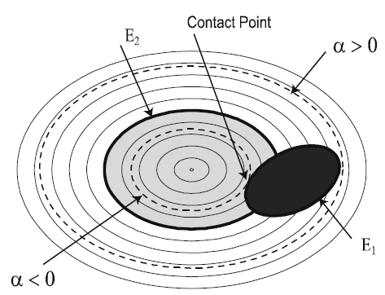
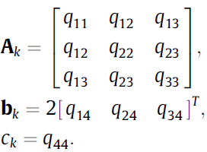








Contact point
Ellipsoid equation
Contact point
Find $τ$ and $x(τ)$: not unique
Choose $τ$ and $x\left(τ\right)$ with minimum $α$
Repeat for E2
$$y\left(τ\right)={(A_{2}+τA_{1})}^{∗}(b_{2}+τb_{1})$$
$A^{∗}$: adjoint matrix of $A_{2}+τA_{1}$
$$Φ\left(τ\right)=det⁡(A_{2}+τA_{1})$$

Slide 23
Contact point

